Slide 1

Bright Coffee Shop Analysis
Bright Learn

Slide 2
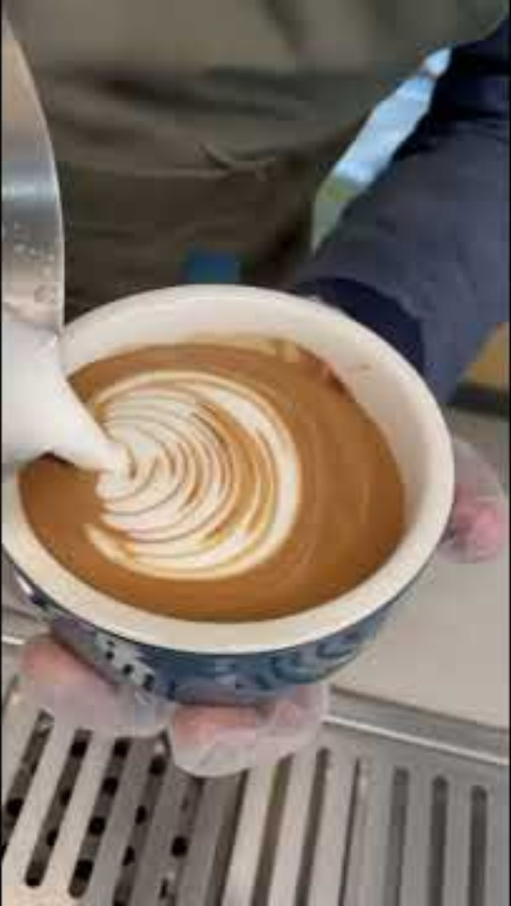

Slide 3
High Performance
Barista Expresso is the most selling product and it has generated the highest revenue that exceed R90,000,00 while Brewed Chai tea is the second highest selling, hot chocolate being the third and the forth selling one is Gourmet brewed coffee. These are the best selling product generating revenue from R70,000 to +R90,000

Slide 4
Comparison of revenue between store and week
Revenue by Location
Revenue by week
Hell’s kitchen has the highest revenue as shown on the chart while Astoria and Lower Manhattan are almost equal in revenue.
The coffee shop generates more revenue during weekdays compared to weekends. This may be because customers are more active during the week due to work routines, while on weekends, many people stay at home and prepare their own beverages..

Slide 5

Revenue by the three stores from jan to Jun
The revenue from January to February decreased and started picking up from the month of march to June. Hell’s kitchen having the highest revenue every month while Astoria and Lower Manhattan made almost the same amount of money, with only small differences between them
Hell’s kitchen – Best
Astoria
Lower Manhattan

Slide 6

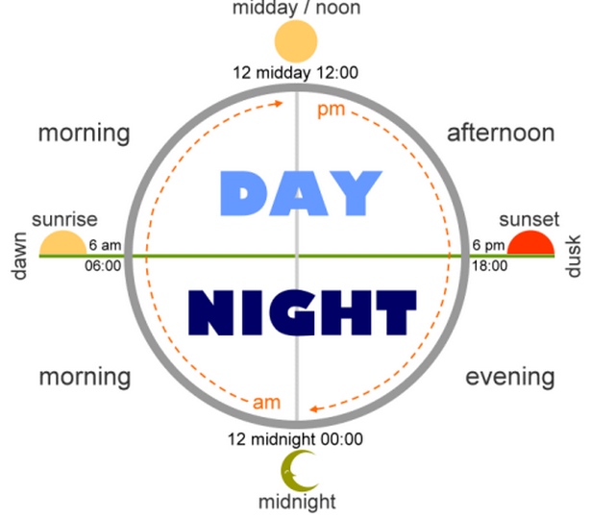
Morning hours
00:00:00 am – 11:59:59 am
Morning hours from 00:00:00 to 11:59:59 has the highest sales compared to afternoon and evening hours. This is likely due to customers purchasing coffee and breakfast items at the start of their day.

Slide 7
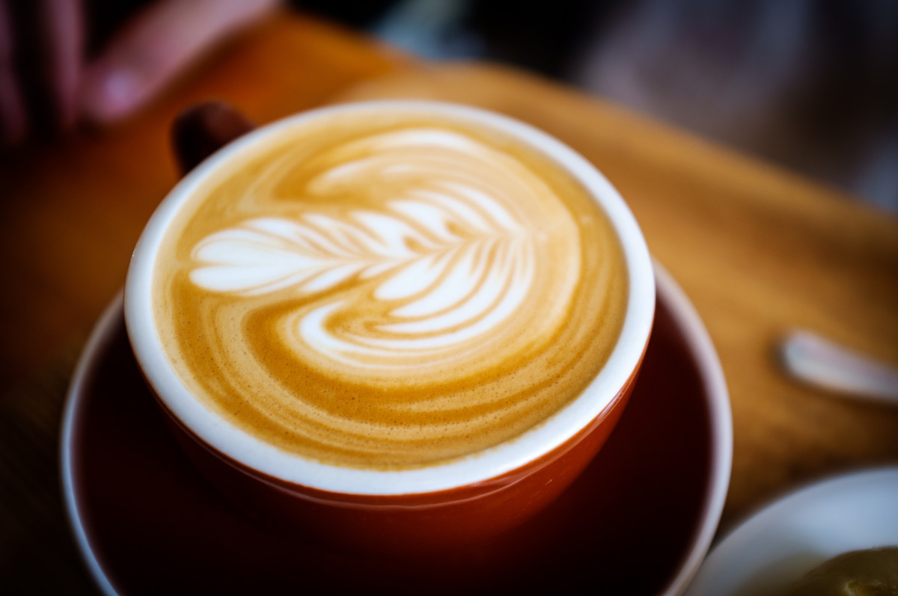
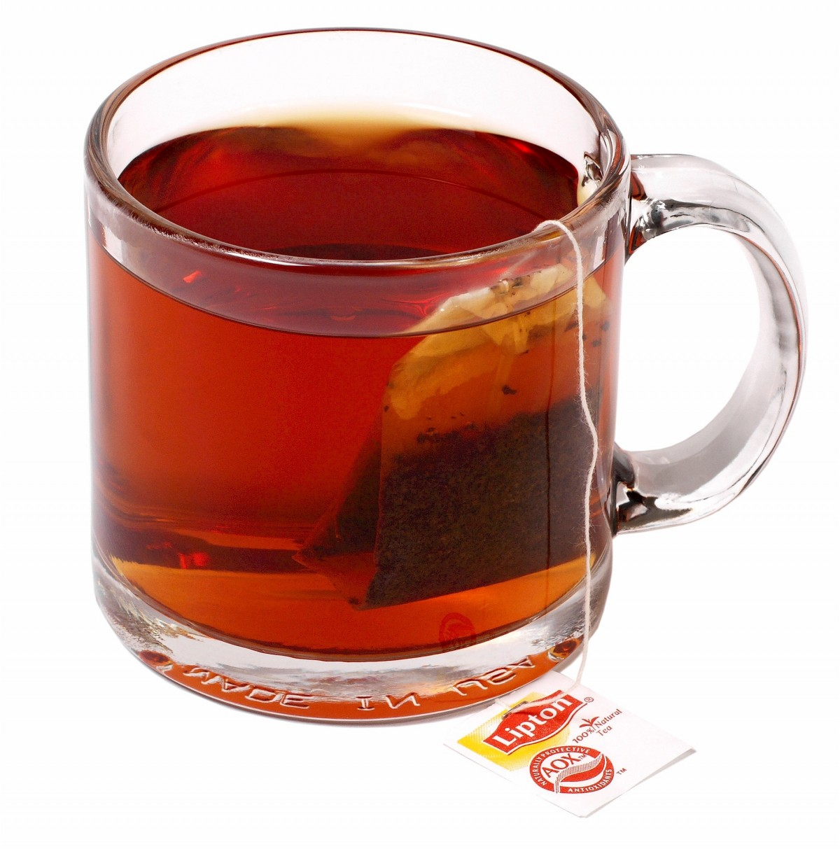
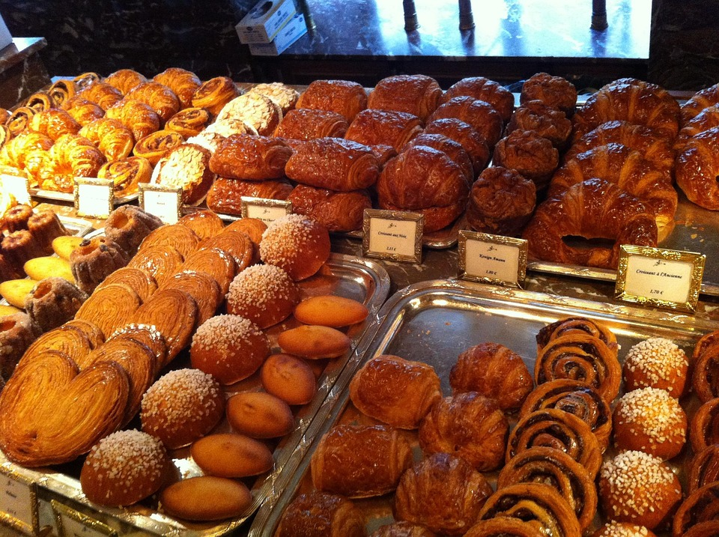
Quantity sold by product category
Coffee has the highest number of items sold, followed by tea, with bakery products ranking third.

Slide 8
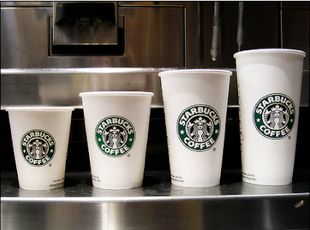
Product details and revenue per day
Large and regular size products are the most selling ones and are generating more revenue especially the tea and coffee categories.

Slide 9
Recommendations
Hell’s kitchen has the highest revenue compared to all the others. The CEO should implement the same strategies they use from this location to the other locations.
Products categories such as Branded, loose tea, coffee beans and packaged chocolate must not be sold every month since they generate less revenue.
Sales are lower in the evening, so the store should focus on selling specific products during that time
The coffee shop should run specials for generating more revenue on weekends to increase revenue
Ensure that high-performing products like Barista Espresso are always in stock across all locations.

